Slide 1
Rabbit Disqualifications
By: Josh Chollett

Slide 2
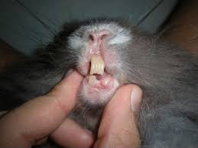
Malocclusion Missing Teeth

Slide 3
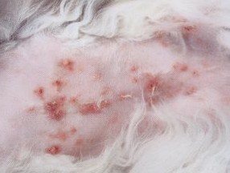
Ear Canker Ear Mites

Slide 4
Missing toenails

Slide 5
Sore Hocks

Slide 6
Nasal Mucus

Slide 7
Cyst or Tumors

Slide 8
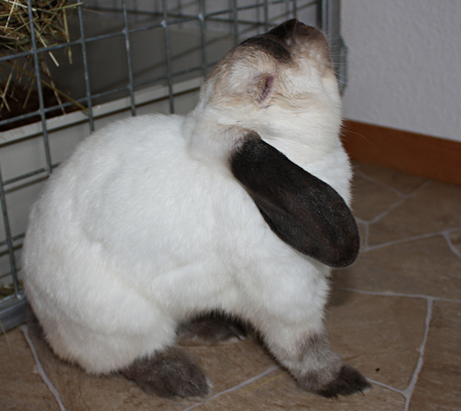
Pneumonia

Slide 9
Broken Tails

Slide 10
Abscess

Slide 11
Scours and Diarrhea

